Slide 1
SCM 651: Business Analytics
Session 1

Slide 2
Business Analytics
Instructor: Don Harter
Office: 517 Whitman School
Phone: (315) 443-3502
Office Hours: Mon, Tue, Wed, Thur 9-10AM
via Zoom
Email: dharter@syr.edu
Course page: http://blackboard.syr.edu/

Slide 3
Agenda
Introductions
Why Business Analytics?
Course Overview
What is Business Analytics?
What Makes Business Analytics Difficult?
Case Study: Offshore Oil Rigs

Slide 4
Introductions
My background …
Why would you take Business Analytics … if it were not required?

Slide 5
Overview
Course overview
Designed in fall 2013
Met with executives to identify technology and techniques
McKinsey, IRI, Proctor & Gamble, Unilever, National Grid, Constellation Brands, VWR International, Publicis Kaplan Thayer, Transaver
Objective: include technology & business interpretation of results
Reviewed ~50 books – no book purchase required
Will use software recommended by executives – Excel, Access, Google Analytics, R, Tableau
Basis for analytics courses in Accounting, Finance, Marketing, and Supply Chain Management

Slide 6

Course Objectives
Understand terminology
Acquire a set of tools
If the only tool you have is a hammer,
then every problem looks like a nail
Learn how and when to use the tools
https://pixnio.com/objects/tools/hammer-nail-screw-screwdriver-wood-tool-metal#

Slide 7
Course content
Syllabus review
Four group homework assignments
Individual final exam
Section M001: May 9, 2022, 12:45 PM – 2:45 PM
Section M002: May 9, 2022, 10:15 AM – 12:15 PM
Grading curve
May be adjusted at end of semester

Slide 8
Assignments
Assignment Weight
Homework (group assignments) 50%
Pivot tables, correlation, regression (MS Excel)
Linear and non-linear regression, optimization (MS Excel)
Google analytics and MS Access
Regression assumptions and model selection (R)
Choice models (logit, probit), moderating effects (R)
Daily Kahoot quiz 0%
There will be an online quiz with 10 questions at the end of each class session
This is good practice for the final exam
Final Exam (individual – in class) 50%

Slide 9
Textbooks, Readings, Software
No required textbook (see recommended textbook)
Handouts every week
Bibliography
At end of syllabus
Additional readings
Posted to BlackBoard throughout the semester
http://blackboard.syr.edu
All software available in computer labs, free download to your computer, or via remote access

Slide 10
Whitman Standards
Academic Integrity
All assignment & project work must be your own original work
Plagiarism or collaboration outside of your team (group assignments) is not permitted
Coordination or collaboration with others on the final exam or weekly Kahoot sessions is not permitted
Classroom
Active participation is strongly recommended
All email is through your syr.edu email account
See syllabus for additional details

Slide 11
What is Business Analytics?

Slide 12
Business Analytics: What is it?
Analytics facilitates realization of business objectives through reporting of data to analyze trends, creating predictive models for forecasting and optimizing business processes for enhanced performance
Informs.org

Slide 13
Types of Analytics
Prescriptive
Analytics
Low High
Predictive
Analytics
Competitive Advantage
Descriptive
Analytics
Low High
Complexity
“Managerial Analytics: An Applied Guide to Principles, Methods, Tools, and Best Practices,” 2013, Watson & Nelson, Page 15

Slide 14
Types of Analytics
Descriptive Analytics
Describe the data to better understand facts and make better decisions
Start with visualization
Predictive Analytics
Forecasting and modeling
Cluster analysis, regression, neural networks
Prescriptive Analytics
Optimization
“Managerial Analytics: An Applied Guide to Principles, Methods, Tools, and Best Practices,” 2013, Watson & Nelson, Pages 93-195

Slide 15
Business Analytics Capability Chart
Deep understanding
of statistical techniques
Competitive Advantage
Analytics Difficulty
Regular Advanced
Summary or spreadsheet
analytics reporting
Involved problem
knowledge
Straightforward Involved
Business Problem Difficulty
“A Practitioner’s Guide to Business Analytics,”
2013, Bartlett, page 52

Slide 16
Business Analytics Applications
Retail sales
Financial services
Risk and credit
Marketing and pricing
Fraud
Inventory control and supply chain

Slide 17
What Drives Business Analytics?
Data!
Volume
Velocity
Variety
Veracity
“A Practitioner’s Guide to Business Analytics,” 2013, Bartlett, page 1
“Managerial Analytics: An Applied Guide to Principles, Methods, Tools, and Best Practices,” 2013, Watson & Nelson, Pages 27-28

Slide 18



What is Driving the Interest in Business Analytics?
1994
2021
5 gigabytes of storage cost $50,000 ($10,000 per gigabyte)
9th largest system in country had 500 gigabytes $5,000,000 (each of 7 sites)
512 gigabytes cost $84.99 at BestBuy ($0.17 per gigabyte)

Slide 19
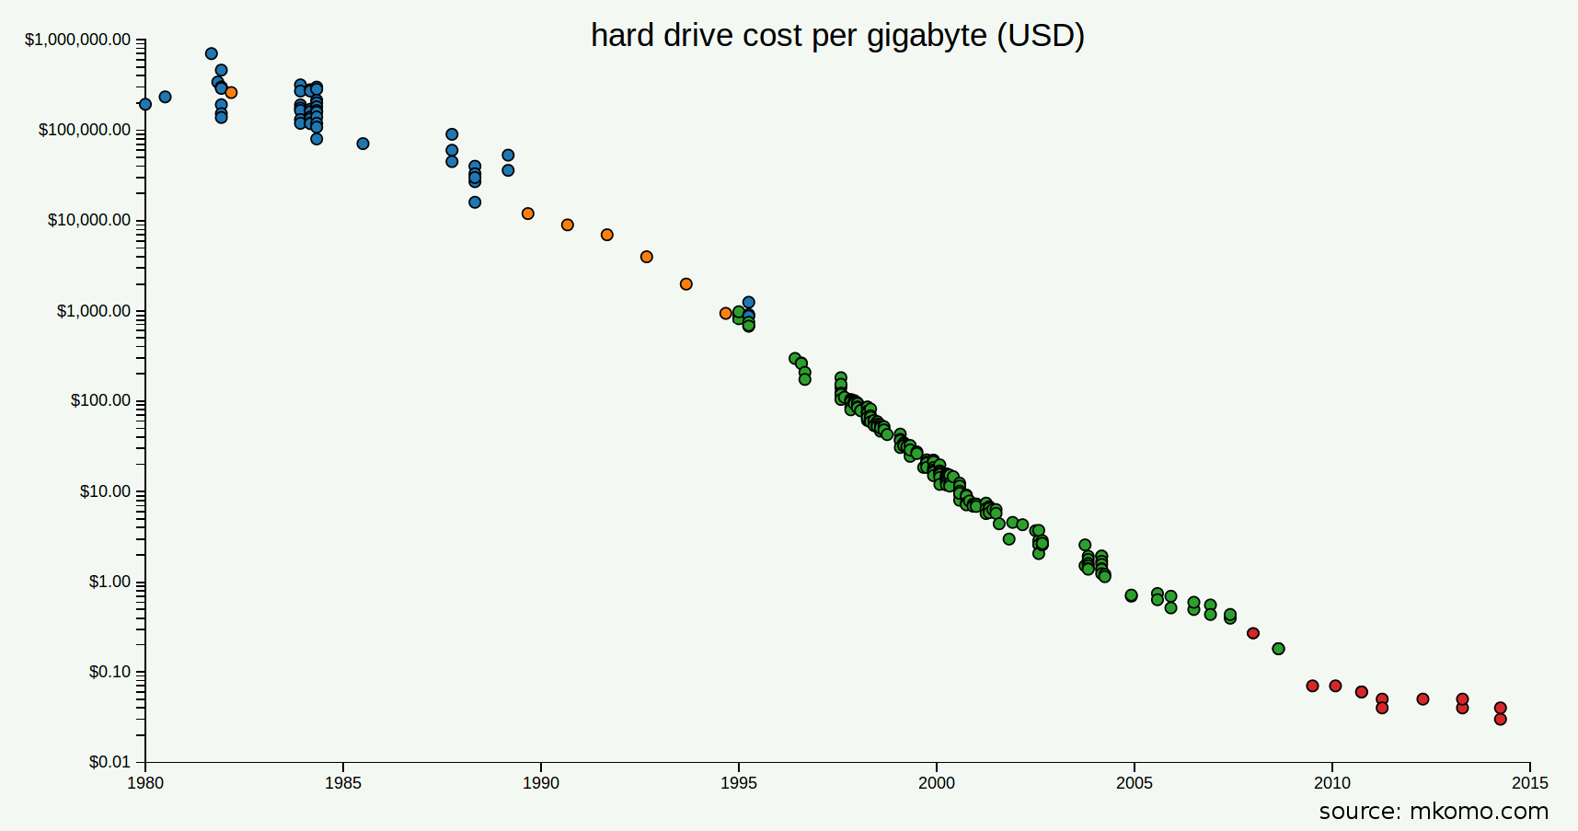
Storage Cost Trend
http://www.mkomo.com/cost-per-gigabyte-update

Slide 20
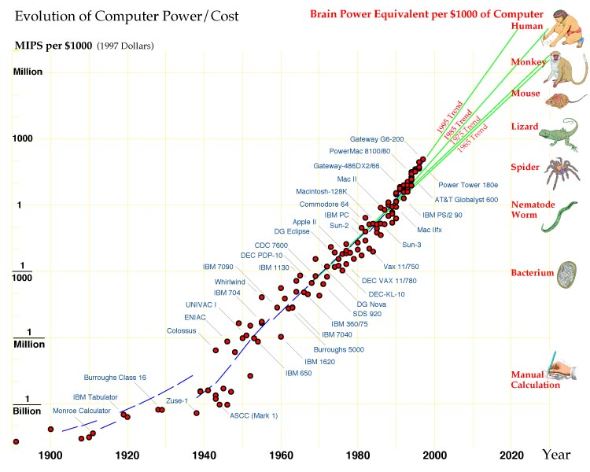
Processor Speed Trend
Hans Moravec: "When will computer hardware match the human brain?"
(1998, Jour. of Transhumanism, Vol.1)

Slide 21
Processor Speed Implications
Gaming
1989: Deep Thought – Carnegie Mellon chess program lost to Gary Kasparov
1997: Deep Blue – IBM chess program beat Gary Kasparov
2011: IBM Watson beat Jeopardy champions
2014: DeepMind set world record for video game Breakout, learned to play Space Invaders, Ms Pac-Man, Q*Bert
2015: Facebook deploys DeepFace facial recognition
2016: Google DeepMind AlphaGo beat Go world champion
Video https://www.youtube.com/watch?v=8tq1C8spV_g
2017 (Jan): AlphaGo Master won 60 straight Go matches
2017 (Oct): AlphaGo Zero learned game without human intervention; beat all previous versions, winning 100-0
2017 (Dec): AlphaGo Zero generalized to learn chess, shogi, and Go in less than 24 hours, beating all previous champion systems

Slide 22
AlphaGo Zero – Game of Go
https://en.chessbase.com/post/the-future-is-here-alphazero-learns-chess

Slide 23
Processor Speed Implications
Self-driving vehicles
1984-92: Self-driving cars (Navlab, ALVINN)
2005: DARPA Grand Challenge – self-driving competition over 132 miles (212 km)
2007: DARPA Urban Challenge – self-driving competition through city traffic
Voice recognition
2010: SIRI voice assistant
2014: SIRI/Shazam music recognition

Slide 24
Processor Speed Implications
Latest Advances
November 2016: Google Brain develops encryption algorithms
March 2017: DeepStack defeats poker champions, develops intuition
July 2017: Facebook AI develops own language
August 2017: AI defeats world champions in multi-player game (Dota 2 [Defense of the Ancients])
May 2019: DeepMind AI uses teamwork to defeat human 'Quake III' players
Neural network created a 3D replica of the universe – July 2019
Neural network detects Covid-19 in real time by Xray – June 2020
Neural network detects COVID-19 via coughs (MIT) – November 2020
Wearable device app CovidDeep detects COVID-19 – Jan 2021

Slide 25
Business Analytics: Why Is It Important?
Herb Simon, Nobel Laureate, Carnegie Mellon
“In an information-rich world, the wealth of information means a dearth of something else: a scarcity of whatever it is that information consumes.”
“What information consumes is rather obvious: it consumes the attention of its recipients.”
“Hence a wealth of information creates a poverty of attention and a need to allocate that attention efficiently among the overabundance of information sources that might consume it.”
http://www.economist.com/node/13350892

Slide 26
What Makes Business Analytics Difficult?

Slide 27
Business Analytics Pitfalls
Information and disinformation overload
Over-analysis
Oversimplification
Deterministic thinking (be careful with causality)
Overdependence on industry knowledge
Tunnel thinking
Overconfidence
Unpiloted big bang launches
“A Practitioner’s Guide to Business Analytics,”
2013, Bartlett, page 59-64

Slide 28
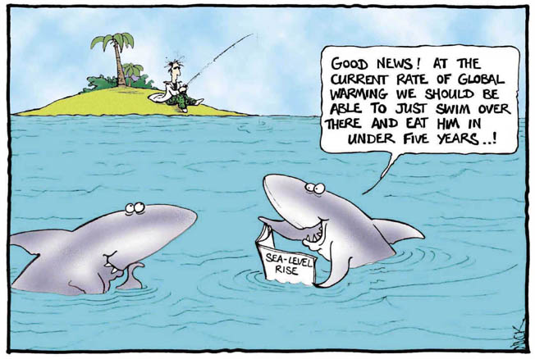

Correlation Example: Pirate Population vs. Global Warming
Data collected from 1860 to 2000 on the pirate population and average global temperature

Slide 29
Correlation or Causal?
Data Courtesy of: FSM (http://www.venganza.org) &
Climatic Research Unit (http://www.cru.uea.ac.uk/)

Slide 30
What else makes it difficult: Cultural Myths
Data in my industry are different – beyond outsider comprehension
Statistical tools in my industry are different – beyond outsider comprehension
“A Practitioner’s Guide to Business Analytics,”
2013, Bartlett, page 78

Slide 31
How do you get these skills?
Business Analytics Training
INFORMS (Institute for Operations Research and the Management Sciences) [informs.org]
Certified Analytics Professional (CAP) started in 2013
Business Analytics Tools
Excel (pivot tables, power query, power pivot, power view, correlation, regression)
Access & SQL (data organization and retrieval)
Google Analytics (trends and Adwords)
R (statistical analysis, data mining, neural networks, SVM, k-means clustering)
Tableau (dashboard representation)
MS Power BI (analysis and dashboards)

Slide 32
Analytics Projects Examples
Automating global decision making
Effect of communications degradation on transportation (Europe)
Distribution systems (European petroleum pipeline)
Global analysis on economic policy
Transportation planning (city evacuation)
Technology modeling (air traffic control)
Financial & supply chain management (inventory control)
Government policy(offshore oil)

Slide 33
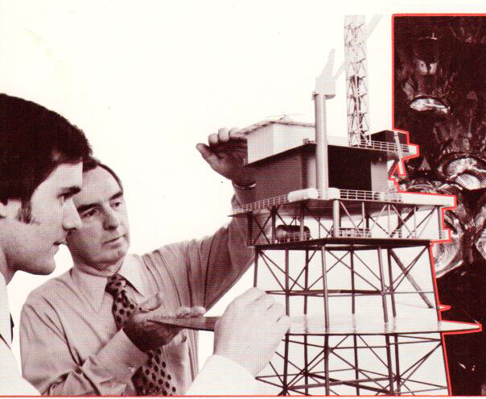
Government Policy: Offshore Oil Rigs
Background:
1973 OPEC oil embargo increased prices
U.S. offshore oil industry responded with new oil rigs
OPEC boosted production to drive out U.S. offshore oil, bankrupting oil rig companies
Problem:
How to ensure stable oil supplies in U.S.
“A technology assessment of offshore industry and its impact
on the maritime industry, 1976-2000,” by James Durfee, et al

Slide 34
How Was the Oil Rig Analytics Project Performed?
Detailed data collection on economy, oil prices, oil rig construction
Non-linear regression analysis to identify relationships
Develop of differential equation models to represent economy and oil rig construction demand
Modeling of differential equation models using government supercomputers to identify sensitivities to changes in price of oil
Insight: oil rig demand curve had inflection point at $50/barrel
Result: when oil price rose above $50, offshore rig construction boomed; below $50, offshore rig construction companies went bankrupt
If oil is a strategic resource for the defense of the US, and the oil rig industry is necessary to support that strategic resource, what government policies should exist to protect the industry?

Slide 35
Oil Rig Demand Curve
Oil Rig Construction
$50/Barrel
(2014 price)
Price of oil

Slide 36
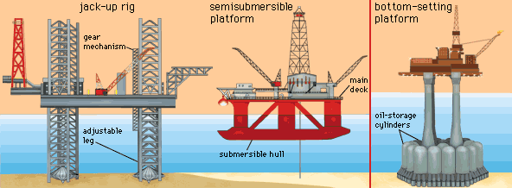
Types of Oil Rigs
https://www.pinterest.com/pin/537828380472450398/

Slide 37
Case Study: Demand for Offshore Oil Rigs
Problem: Oil prices rise due to an OPEC embargo
Question: How long before oil prices drop? How long do they stay low?
Then
Now
Cost to build an offshore oil rig
$100 million investment
2-3 years to build oil rig
6 months to drill
Lease opportunity: $100,000 per day
Problem
Demand depends on the price of oil
Break even price was $50/barrel (2014 price), $15/barrel (1976 price)
Life of oil well
Oil wells last 20 years
Reference: “A technology assessment of offshore industry and its impact on the maritime industry, 1976-2000,” by James Durfee, et al
Cost to build an offshore oil rig
$600-650 million
2-3 years to build oil rig
6 month to drill
Lease opportunity: $500,000-$600,000 per day
Problem
Demand depends on the price of oil
Reference:
http://www.bloomberg.com/news/2012-03-18/maersk-drilling-to-spend-much-as-6-billion-on-oil-rigs.html
http://www.diamondoffshore.com/offshore-drilling-basics
http://www.theoildrum.com/node/586
https://www.investopedia.com/ask/answers/061115/how-do-average-costs-compare-different-types-oil-drilling-rigs.asp

Slide 38
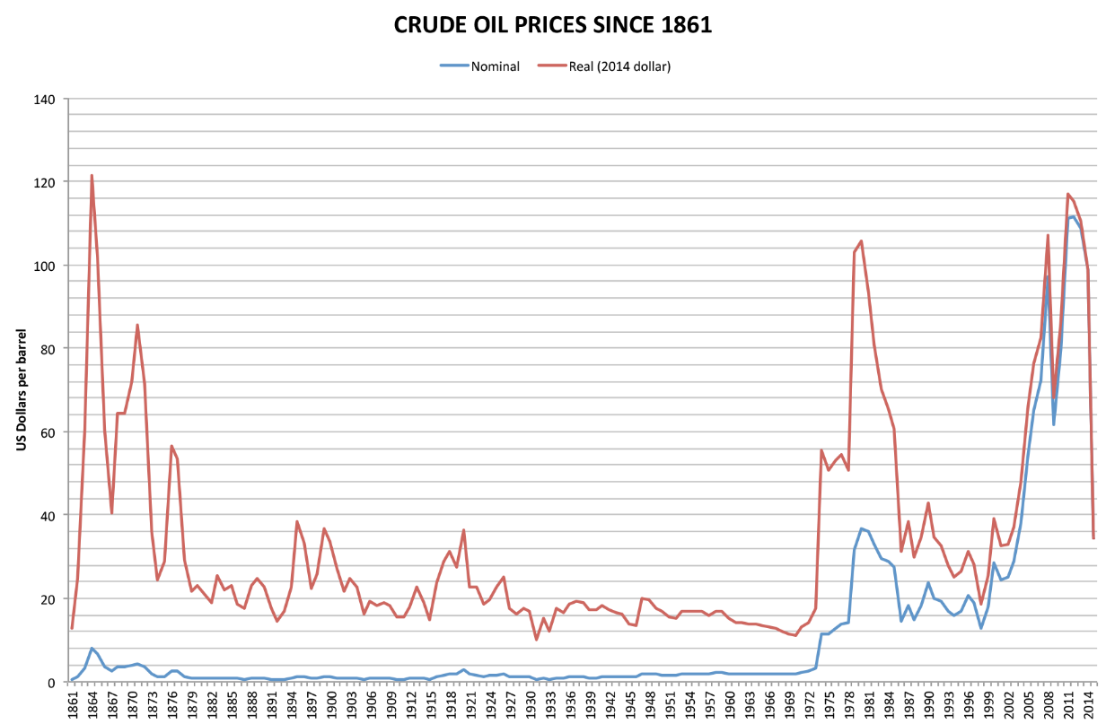
Oil Prices
Question: How long before oil prices drop? How long do they stay low?
http://en.wikipedia.org/wiki/Price_of_oil
By Jashuah - Own work by uploader, data from BP workbook of historical data, CC BY-SA 3.0, https://commons.wikimedia.org/w/index.php?curid=20745151

Slide 39
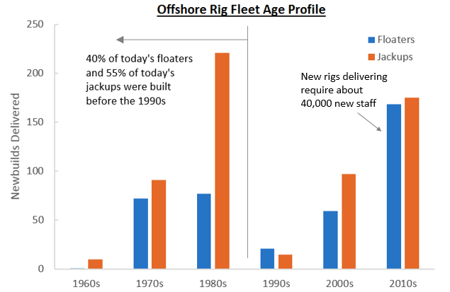
Oil Rig Construction
http://oilpro.com/post/4002/the-us-oil-renaissance-

Slide 40
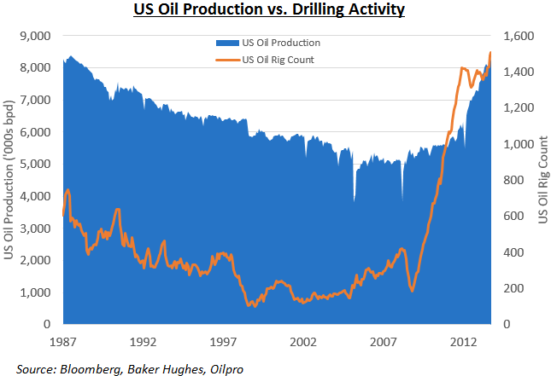
Oil Rigs & Oil Production
http://oilpro.com/post/4004/deepwater-drilling--you-must-hire-before-you-retire

Slide 41
Cost to Produce and Budgetary Requirement (2014)
Country | Cost to Produce | Budget Requirement
Saudi Arabia | $8.98/barrel ⁽¹⁾ | $104.4/barrel ⁽²⁾
Iran | $10/barrel ⁽¹⁾
Iraq | $10/barrel ⁽¹⁾ | $101.0/barrel ⁽²⁾
Russia | $19/barrel ⁽¹⁾ | $105.2/barrel ⁽²⁾
Canada | $26.24/barrel ⁽¹⁾ $90/barrel sand ⁽²⁾
U.K. | $44.33/barrel ⁽¹⁾
U.S. | $57/barrel offshore ⁽²⁾ $73/barrel shale ⁽²⁾
(1) http://theconversation.com/understanding-the-rollercoaster-ride-of-oil-prices-97848
(2) https://knoema.com/vyronoe/cost-of-oil-production-by-country
(3) https://knoema.com/rqaebad/cost-of-producing-a-barrel-of-crude-oil-by-country

Slide 42
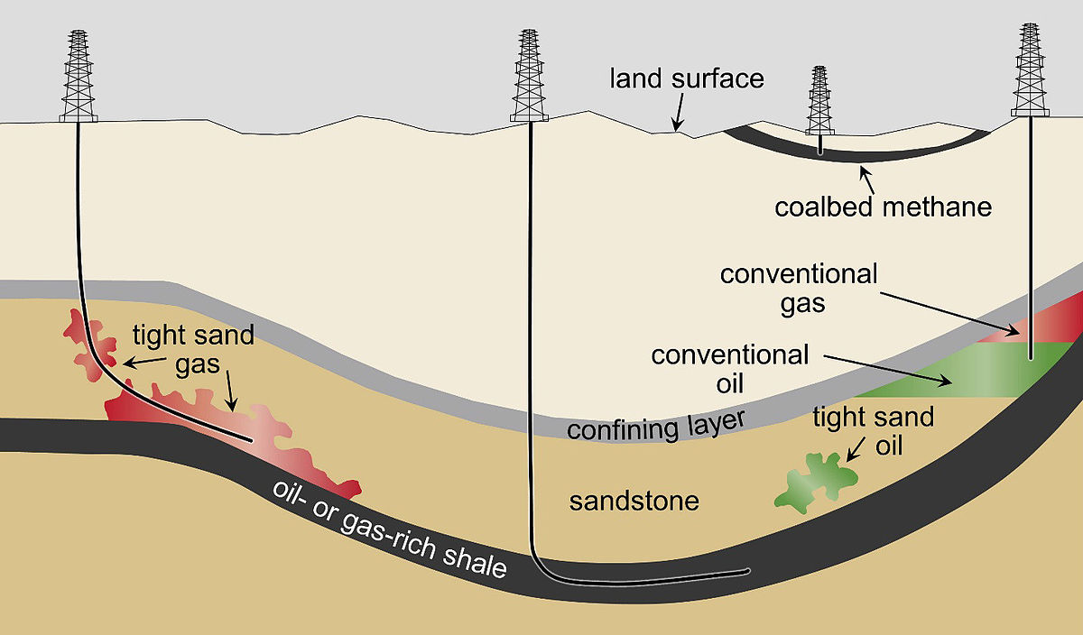
Introduction of Shale Oil - 2008
https://en.wikipedia.org/wiki/Tight_oil

Slide 43
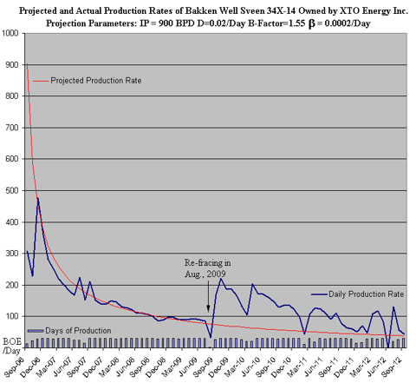
Today: Predicting Cost of Oil When Shale Oil is a Factor
Breakeven cost for U.S. hydraulic shale is $45-65 per barrel in 2014, (Rystad Energy and Morgan Stanley)
Shale well drilling: 20-30 days
Shale wells
70% productive after one year
30% productive after two years
<10% productive after three years
References:
http://fortune.com/2015/01/09/oil-prices-shale-fracking/
http://loga.la/louisiana-shale-plays/shale-drilling/
https://www.quora.com/What-is-the-average-life-of-a-shale-oil-well-in-the-Bakken-formation

Slide 44
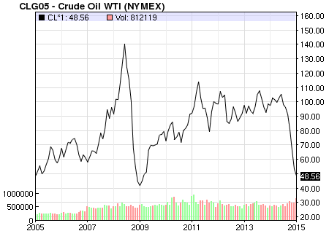
Effect of Shale Oil on Price: 2014 Production Drives Down Price
U.S. becomes biggest oil producer in 2014
References:
http://www.bloomberg.com/news/2014-07-04/u-s-seen-as-biggest-oil-producer-after-overtaking-saudi.html
http://www.nasdaq.com/markets/crude-oil.aspx?timeframe=10y
Problem: Oil prices drop due to oil shale production & OPEC
Question: What is the minimum price for oil? How long before oil prices rise?

Slide 45
Oil Industry Insights
High prices last as long as it takes to bring on new production
Low prices last as long as it takes for oil wells to run out of oil
Strategic petroleum reserve was developed to have an emergency reserve of oil and has the effect of reducing sharp changes in prices
80 million barrels of oil produced in a day; decrease in supply of 200,000 barrels increases prices by $10 per barrel
http://theconversation.com/understanding-the-rollercoaster-ride-of-oil-prices-97848

Slide 46
Example of Analytics in Industry
L.L. Bean pricing
Amazon.com pricing
Amazon.com video

Slide 47
Next Steps
Tools
Excel, Access, R, Tableau, MS Power BI (or Google Analytics)
Instructions to download software to be provided later
Teams
Teams will be formed before homework #1 distributed
Data sets
https://www.data.gov/
https://www.kdnuggets.com/datasets/index.html
https://www.kaggle.com/
Video: Hal Varian, Google Analytics
https://www.youtube.com/watch?v=poas_GXSou8#t=142
Test remote desktop support (rds.syr.edu) access
Kahoot

Slide 48
Brazilian
The government statistician gave the president his daily briefing. He concluded by saying: "Yesterday, 3 Brazilian soldiers were killed."
"Oh No!" the president exclaimed, "That's Terrible!"
His staff was stunned at this display of emotion, nervously watching as the president sat, his head in his hands.
Finally, the president looked up and asked,
"Just how many is a brazillion? "
back

